Slide 1




prioritizr Systematic conservation planning in R R
Jeffrey Hanson
jeffrey.hanson@uqconnect.edu.au
prioritizr.net

Slide 2
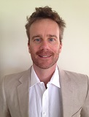
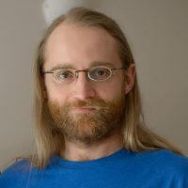
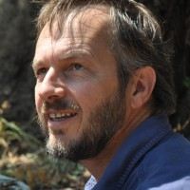
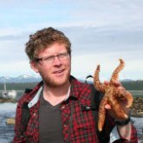
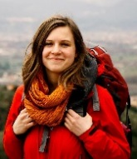
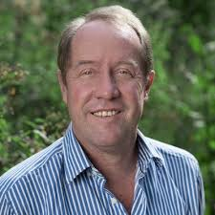
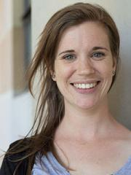
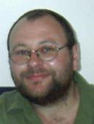


Acknowledgements
Richard Schuster
Matt Strimas-Mackey
Nina Morrell
Matt Watts
Joe Bennett
Peter Arcese
Hugh Possingham
Marie Dade

Slide 3
How should $we
$manage $areas to
$achieve
$conservation?

Slide 4






Slide 5

Objective
Maximize benefit
subject to budget

Slide 6
Objective
Maximize benefit
subject to budget

Slide 7
Objective
Maximize benefit
subject to budget

Slide 8

Objective
Minimize cost
subject to targets

Slide 9
Objective
Minimize cost
subject to targets

Slide 10
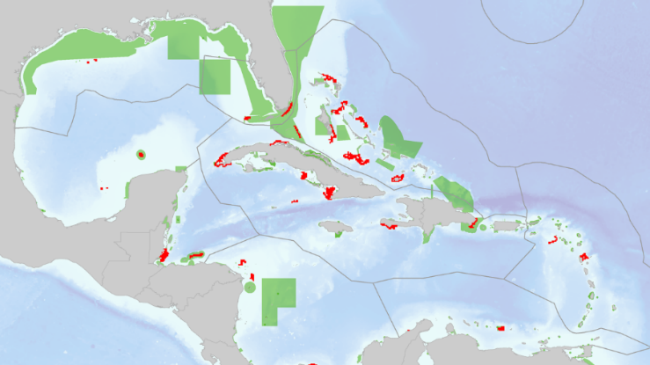
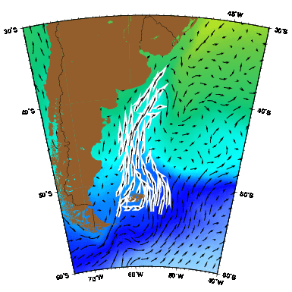
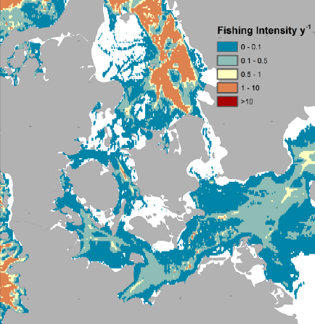
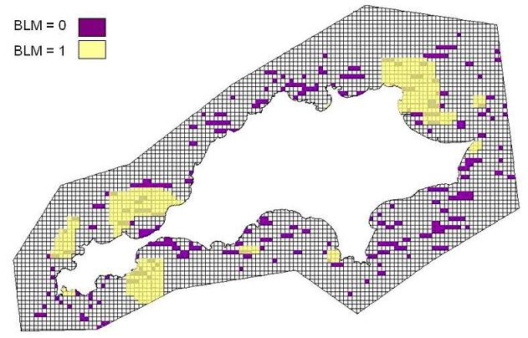
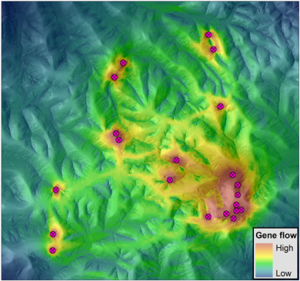
Constraints and Penalties

Slide 11
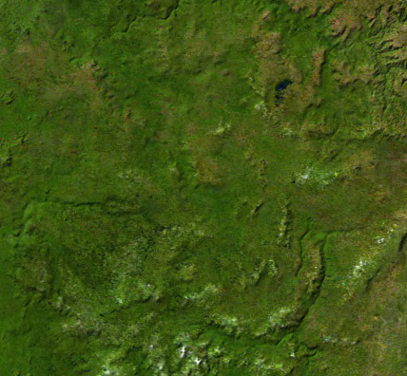
Decision type
Protect or not?
Different amounts?
Multiple actions?

Slide 12





Solver
?
?
?
?

Slide 13

prioritizr
Design your problem
Solve it fast!

Slide 14
Design your problem
Mental model
problem <- data +
objective +
constraints +
penalties +
decision type +
solver
solution <- solve(problem)

Slide 15
Design your problem
Mental model
Code
problem <- data +
objective +
constraints +
penalties +
decision type +
solver
solution <- solve(problem)
p <- problem(areas, feats) %>%
add_min_set_objective() %>%
add_relative_targets(0.1) %>%
add_boundary_penalties(5) %>%
add_binary_decisions() %>%
add_rsymphony_solver()
solution <- solve(p)

Slide 16
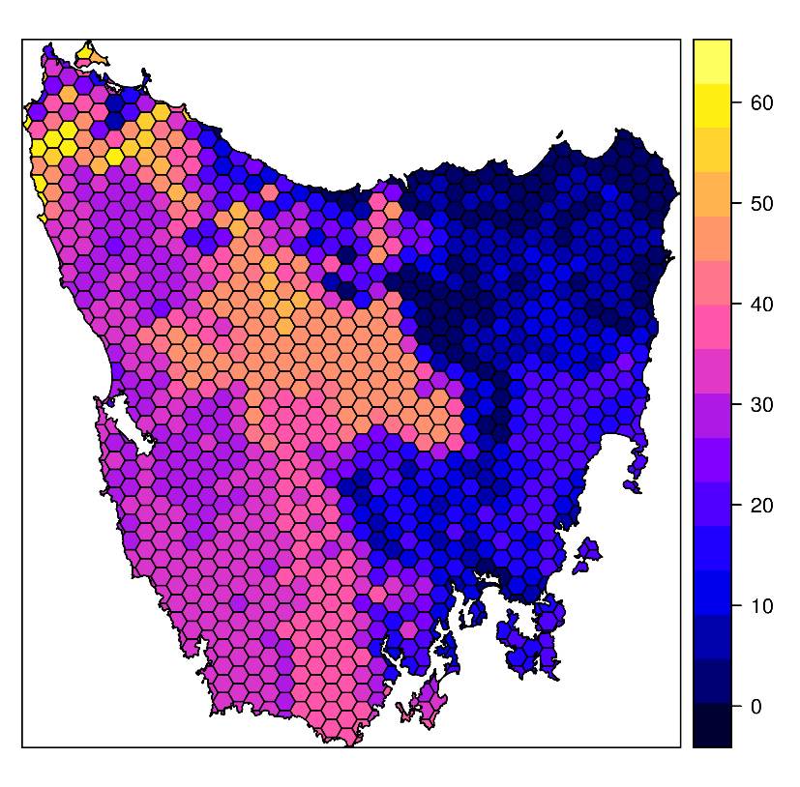
Design your problem
Study area: Tasmania, Australia
Planning units: 1130 hexagons
Features: 63 vegetation types

Slide 17
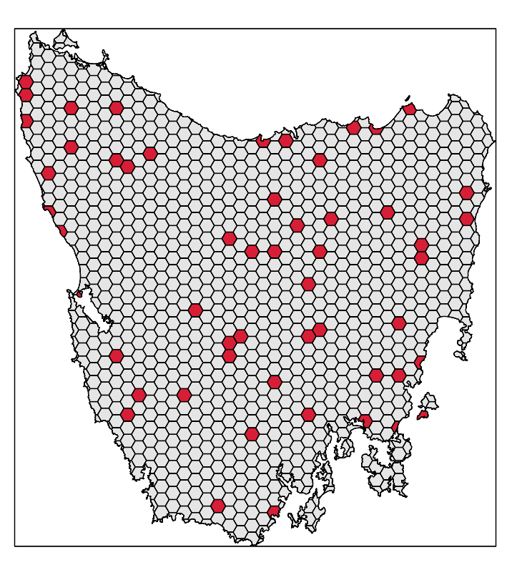
Design your problem
problem(tas_pu, tas_features,
"cost") %>%
add_min_set_objective() %>%
add_relative_targets(0.1) %>% add_binary_decisions() %>%
add_gurobi_solver(gap = 0) %>% solve()

Slide 18
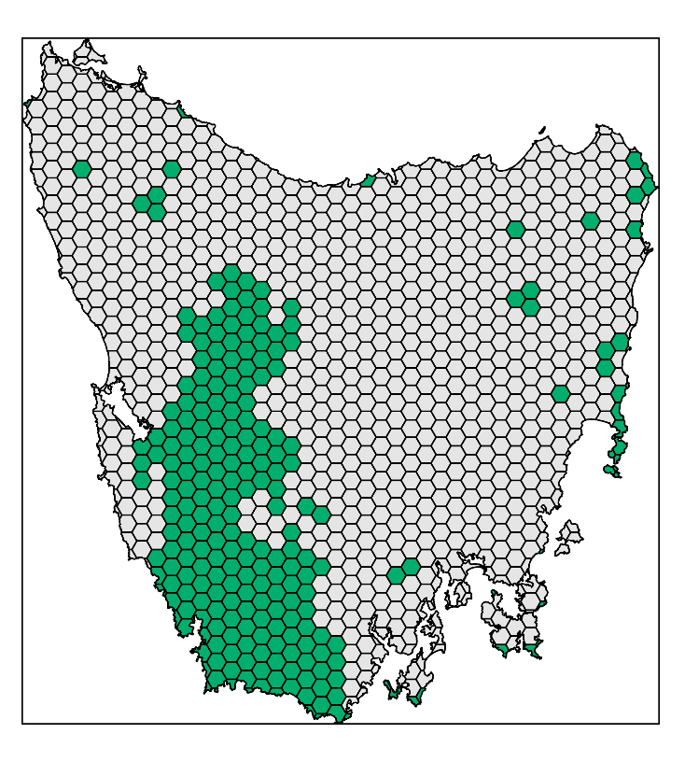
Design your problem
problem(tas_pu, tas_features,
"cost") %>%
add_min_set_objective() %>%
add_relative_targets(0.1) %>% add_locked_in_constraints("in") %>%
add_binary_decisions() %>%
add_gurobi_solver(gap = 0) %>% solve()

Slide 19
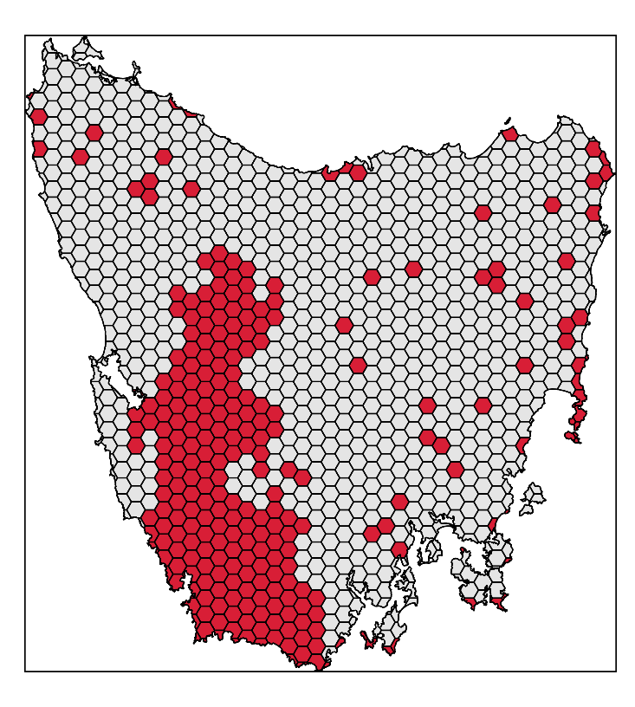
Design your problem
problem(tas_pu, tas_features,
"cost") %>%
add_min_set_objective() %>%
add_relative_targets(0.1) %>% add_locked_in_constraints("in") %>%
add_binary_decisions() %>%
add_gurobi_solver(gap = 0) %>% solve()

Slide 20
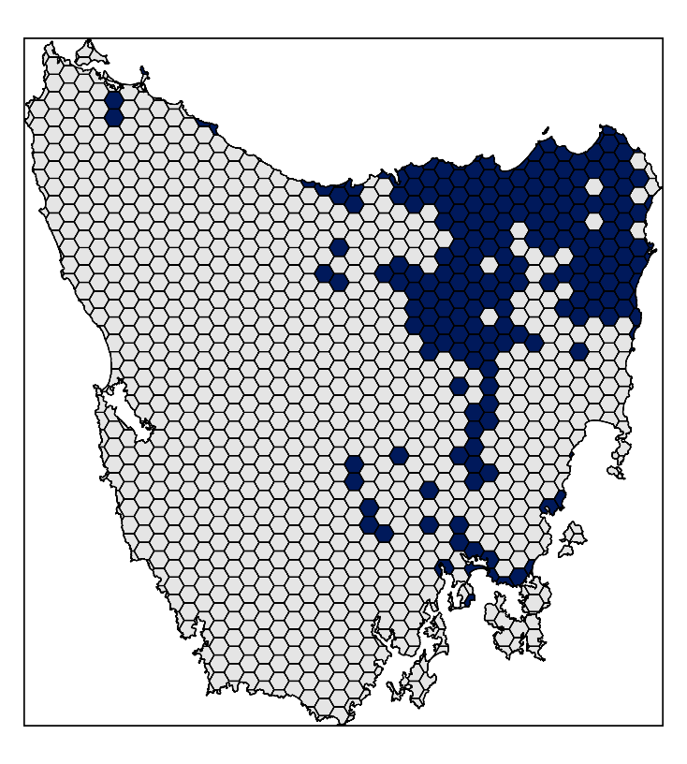
Design your problem
problem(tas_pu, tas_features,
"cost") %>%
add_min_set_objective() %>%
add_relative_targets(0.1) %>% add_locked_in_constraints("in") %>%
add_locked_out_constraints("out") %>%
add_binary_decisions() %>%
add_gurobi_solver(gap = 0) %>% solve()

Slide 21
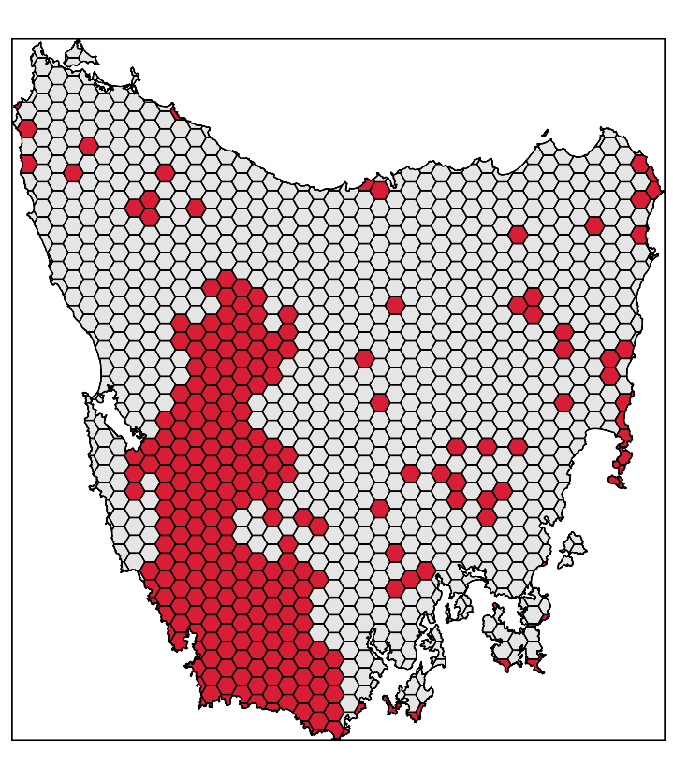
Design your problem
problem(tas_pu, tas_features,
"cost") %>%
add_min_set_objective() %>%
add_relative_targets(0.1) %>% add_locked_in_constraints("in") %>%
add_locked_out_constraints("out") %>%
add_binary_decisions() %>%
add_gurobi_solver(gap = 0) %>% solve()

Slide 22
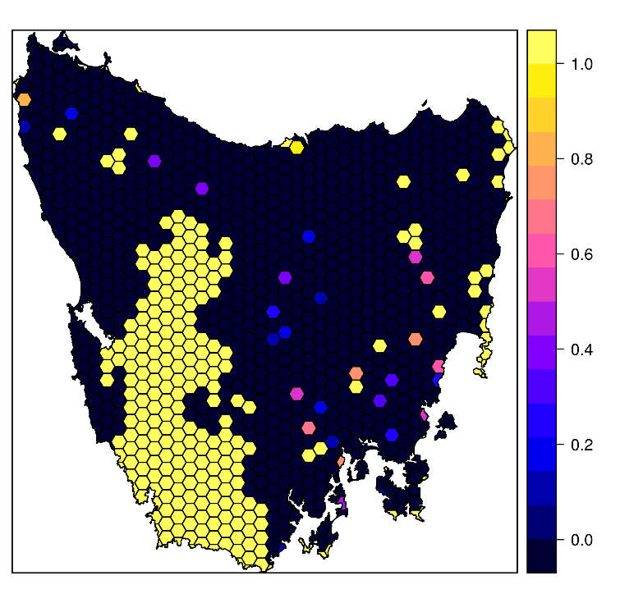
Design your problem
problem(tas_pu, tas_features,
"cost") %>%
add_min_set_objective() %>%
add_relative_targets(0.1) %>% add_locked_in_constraints("in") %>%
add_locked_out_constraints("out") %>%
add_proportion_decisions() %>%
add_gurobi_solver(gap = 0) %>% solve()

Slide 23
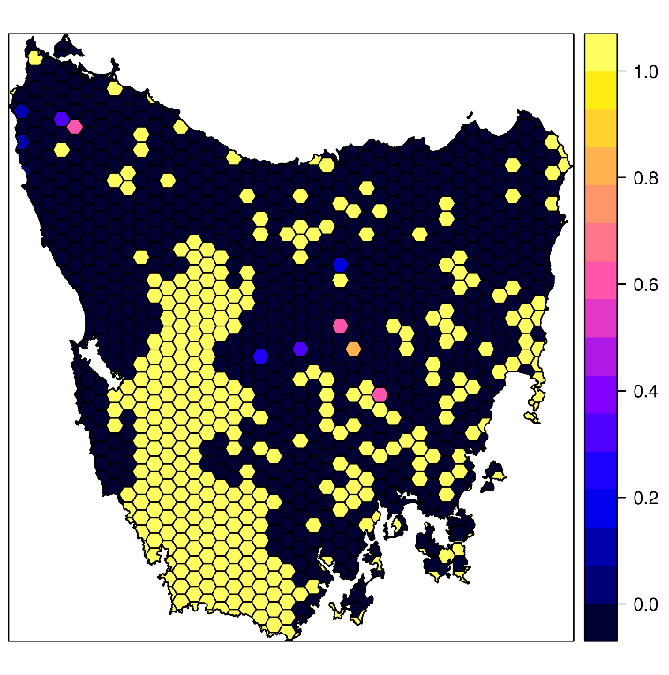
Design your problem
problem(tas_pu, tas_features,
"cost") %>%
add_max_features_objective(budget)%>%
add_relative_targets(0.1) %>% add_locked_in_constraints("in") %>%
add_locked_out_constraints("out") %>%
add_proportion_decisions() %>%
add_gurobi_solver(gap = 0) %>%
solve()

Slide 24
Design your problem
problem(pu, feats, "cost") %>%
add_min_set_objective() %>%
add_relative_targets(…) %>% add_binary_decisions() %>%
solve()
Single zone
problem
problem(pu, zones(z1, z2, …),
c("cost_1", "cost_2", …)) %>%
add_min_set_objective() %>%
add_relative_targets(…) %>% add_binary_decisions() %>%
solve()
Multi-zone
problem

Slide 25
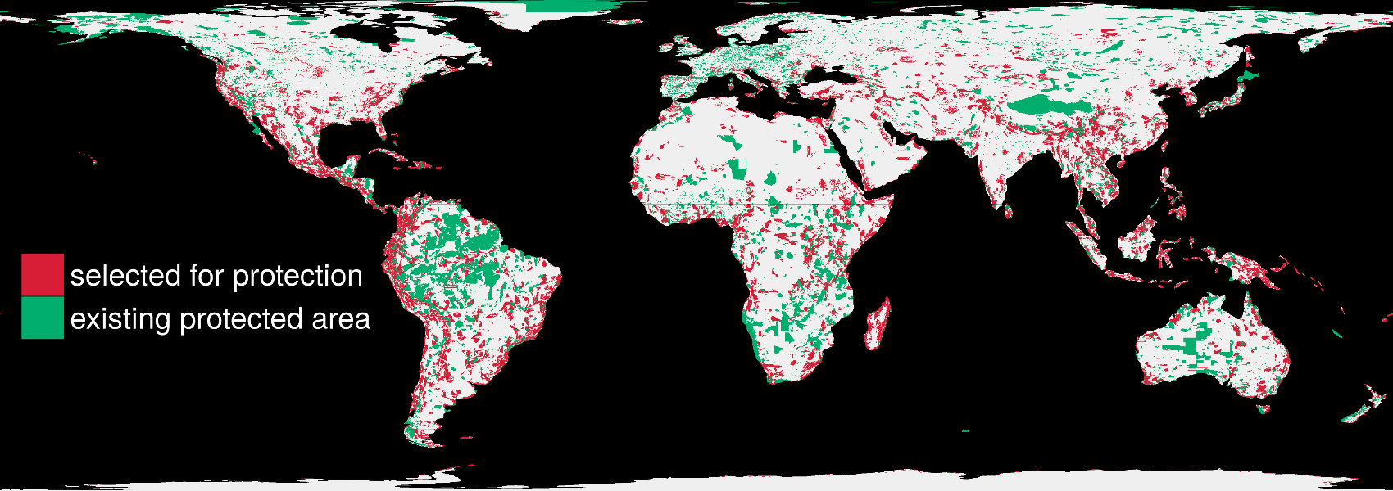
Solve it fast!
1.5 million planning units + 22,644 species: 76 minutes

Slide 26
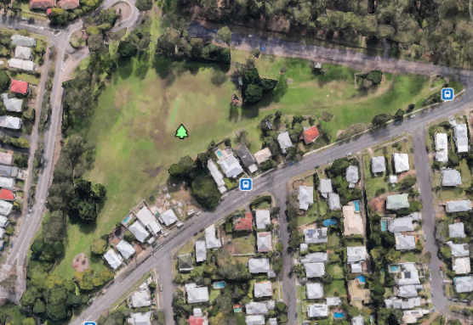
Case-study: Ecosystem services
Services
Carbon storage
Cultural services
Nature interactions
Social interactions
Relaxation
Exercise

Slide 27
Case-study: Ecosystem services
Services
Carbon storage
Cultural services
Nature interactions
Social interactions
Relaxation
Exercise
Actions
Replace grass with trees
Replace trees with grass
Add children’s playground
Add footpath
Add toilet block, BBQ, seating, shade
Do nothing
Combination: 2 + 3+ 4 + 5
Combination: 1 + 3+ 4 + 5

Slide 28
Case-study: Ecosystem services
Carbon storage
Cultural services

Slide 29
Case-study: Ecosystem services
+5% carbon storage
+88 % cultural services
Replace grass with trees
Replace grass with trees, add children’s playgrounds, footpath, toilet block, BBQ, seating, shade

Slide 30
Case-study: Ecosystem services
Carbon storage increase
No increase
Cultural services increase

Slide 31
Future work
Point-and-click interface (prioritizrshiny)
Enhance support for open source solvers
More objectives, constraints, and penalties!

Slide 32
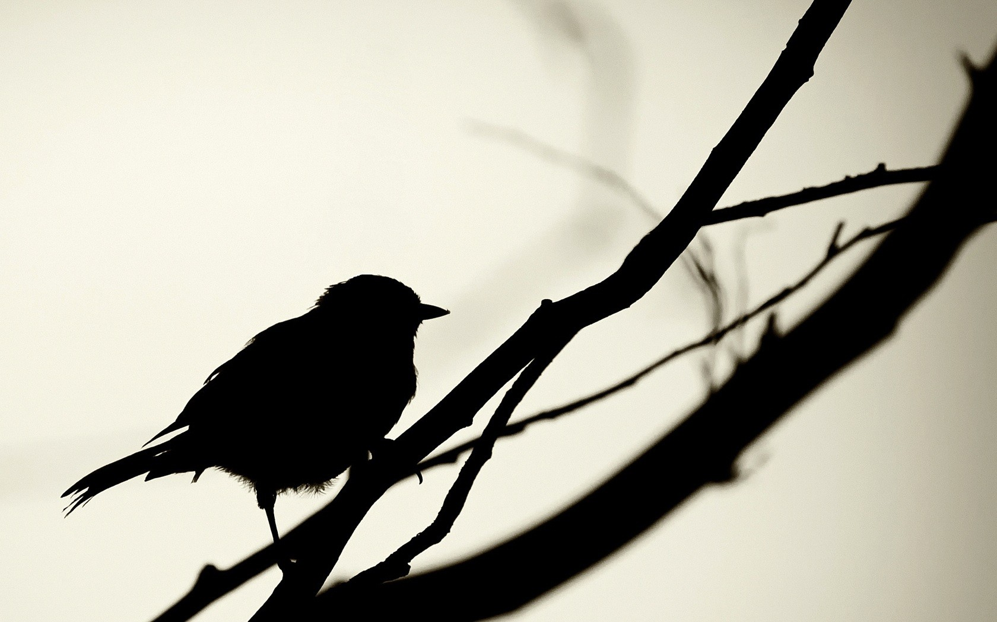


jeffrey.hanson@uqconnect.edu.au
github.com/prioritizr/prioritizr
github.com/prioritizr/teaching
prioritizr.net

